Slide 1
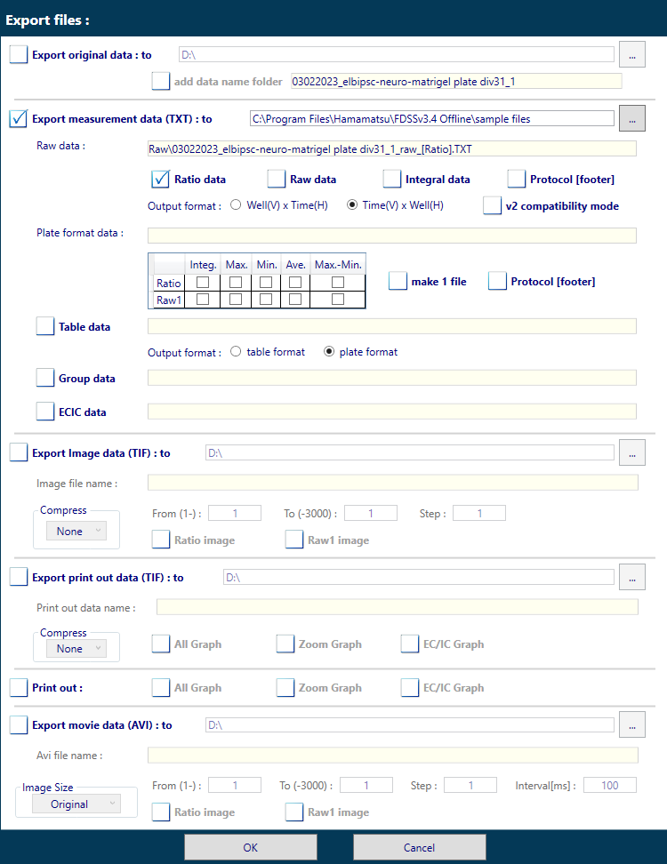
No need to export original data
Export TXT file
Specify Ratio Data
Specify Time(V) x Well(H)
Leave any other settings unchecked

